Slide 1
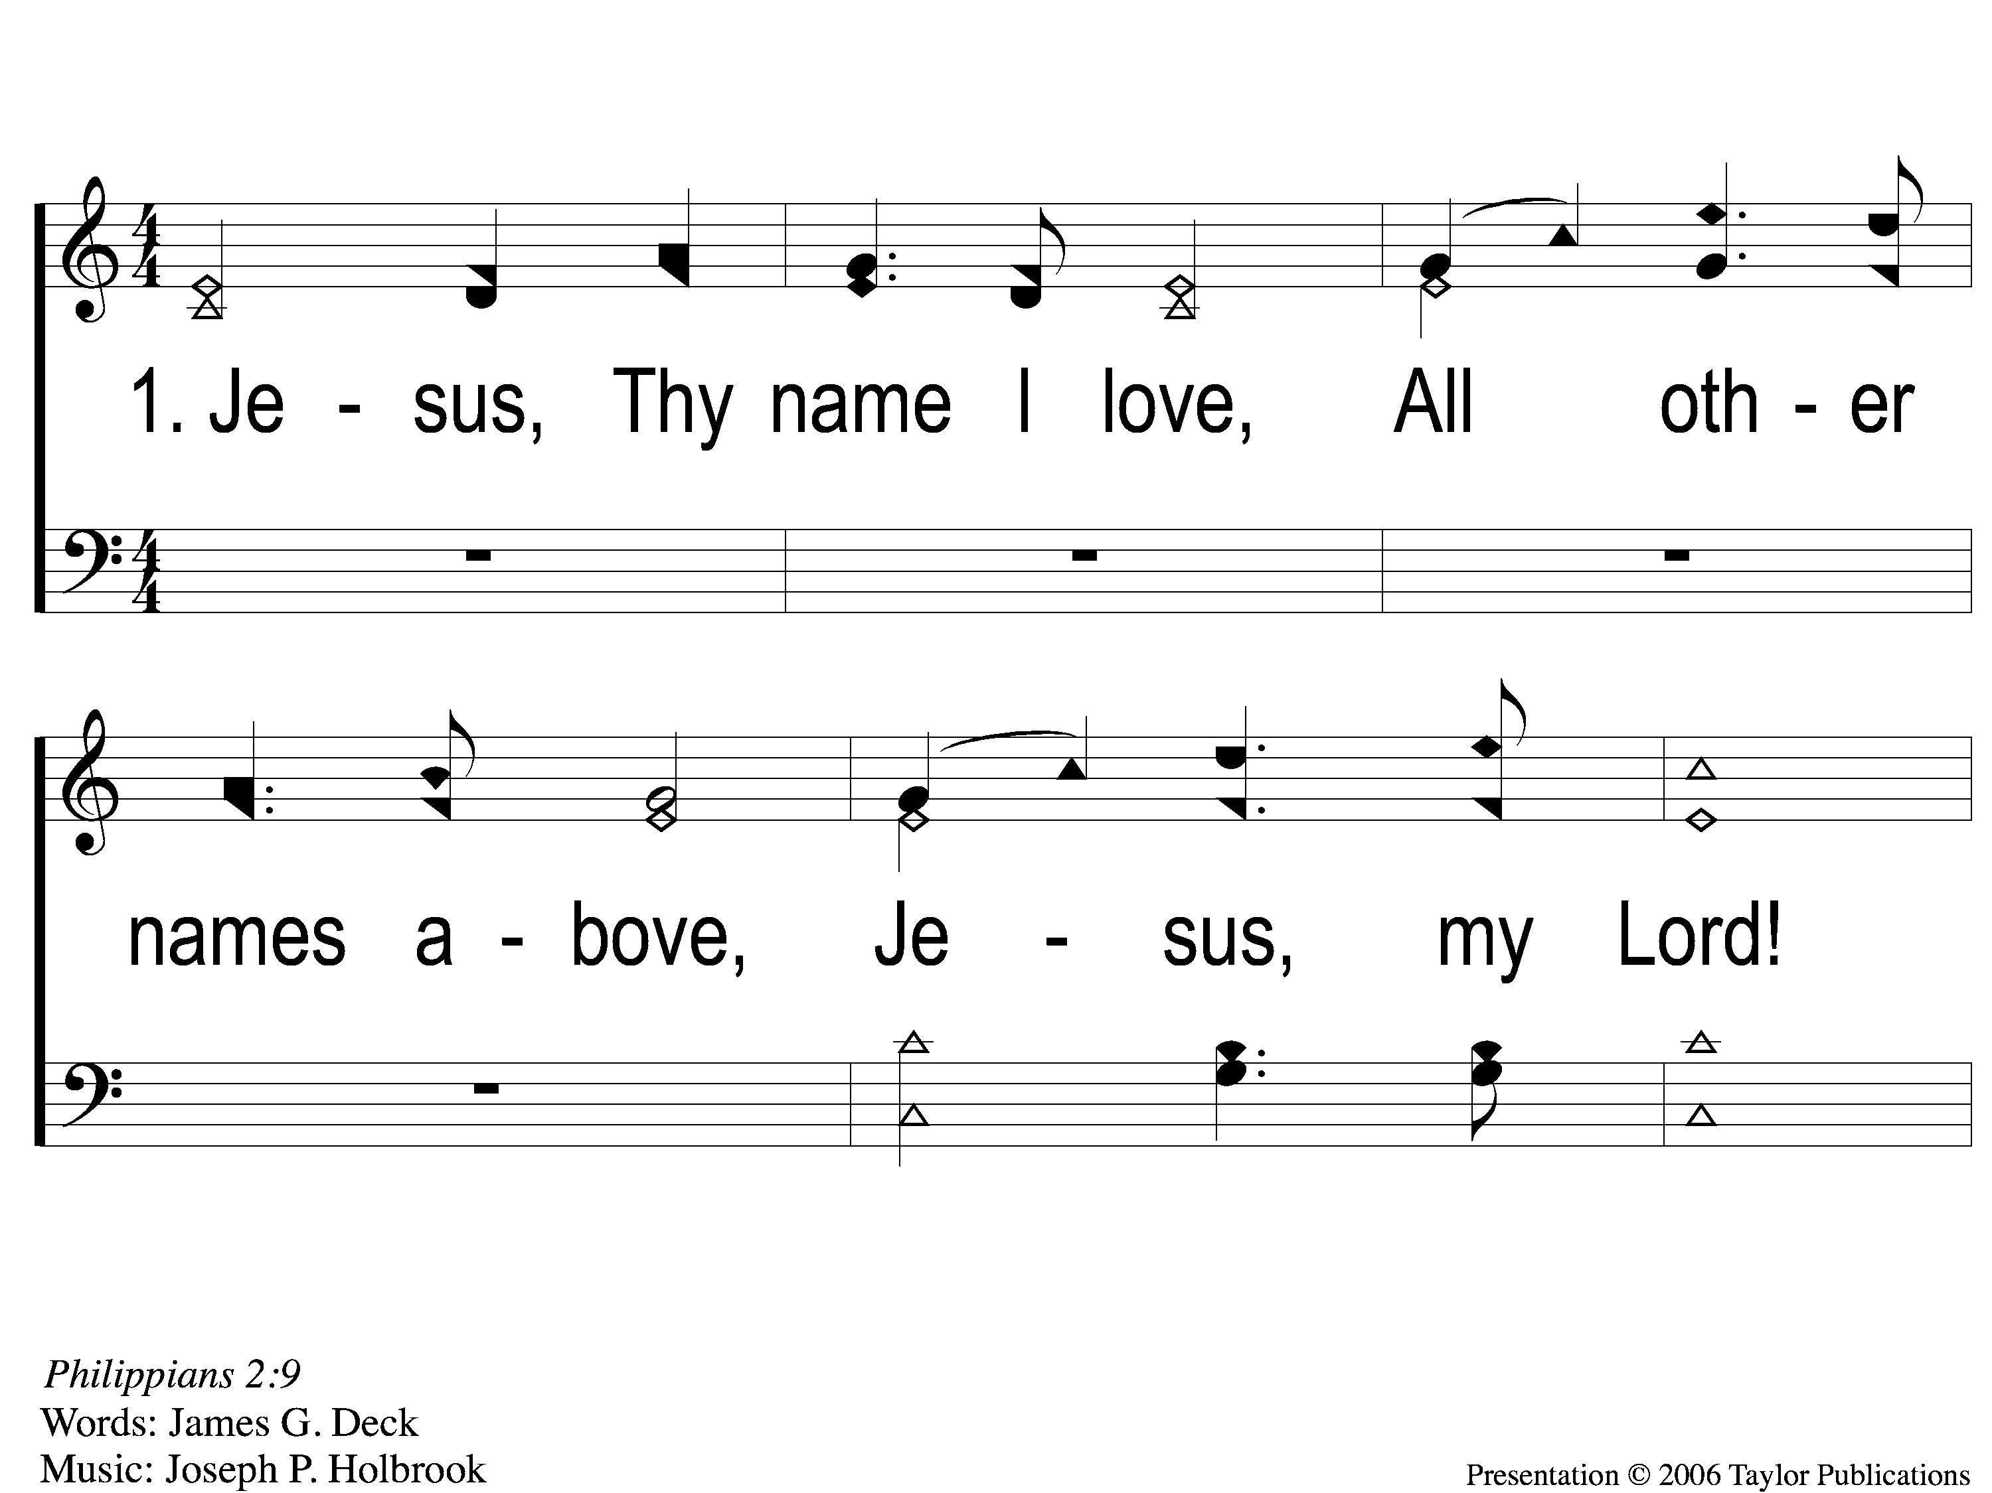
1-1 Jesus Thy Name I Love
Jesus, Thy Name I Love
151

Slide 2
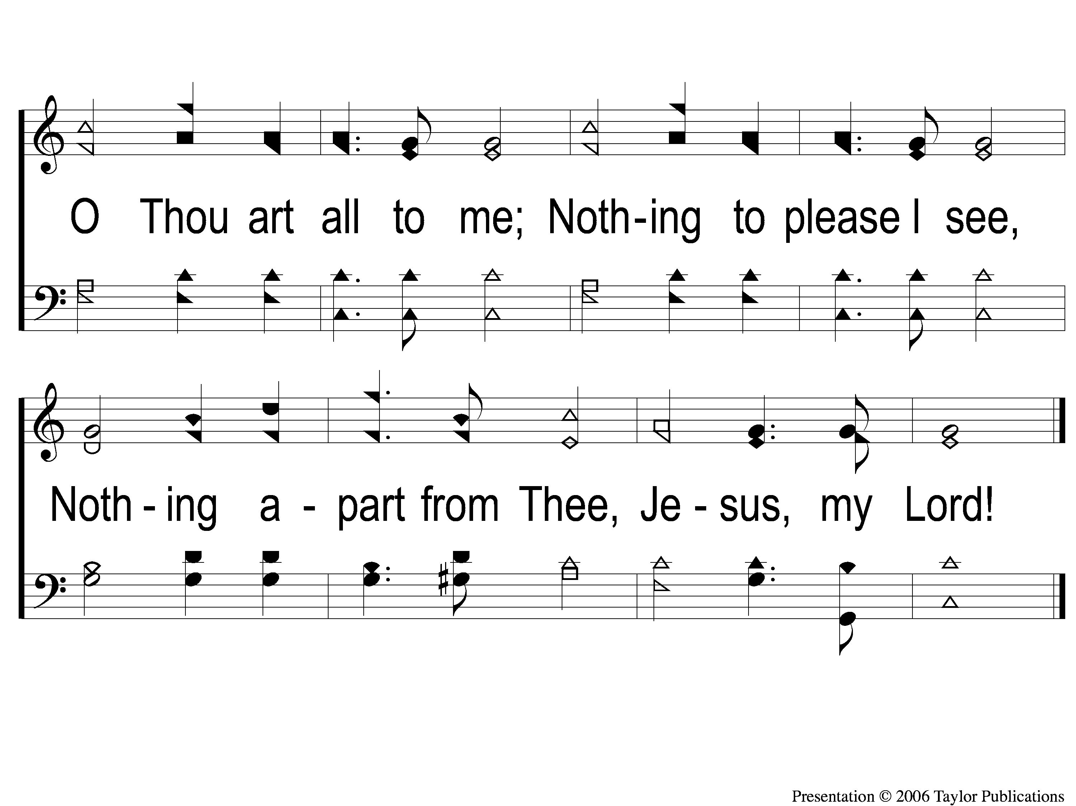
1-2 Jesus Thy Name I Love
Jesus, Thy Name I Love
151

Slide 3
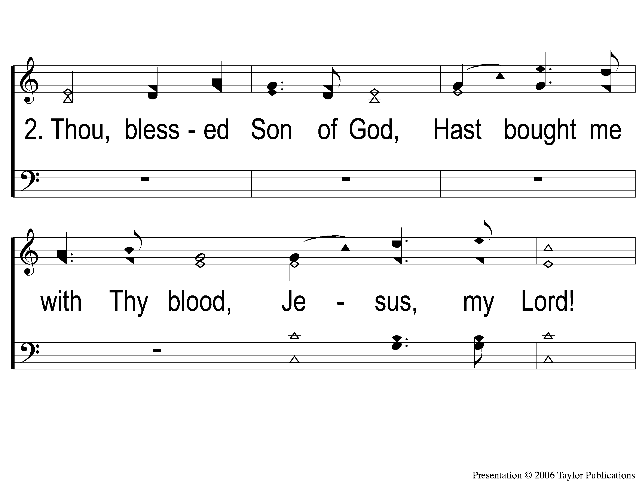
2-1 Jesus Thy Name I Love
Jesus, Thy Name I Love
151

Slide 4
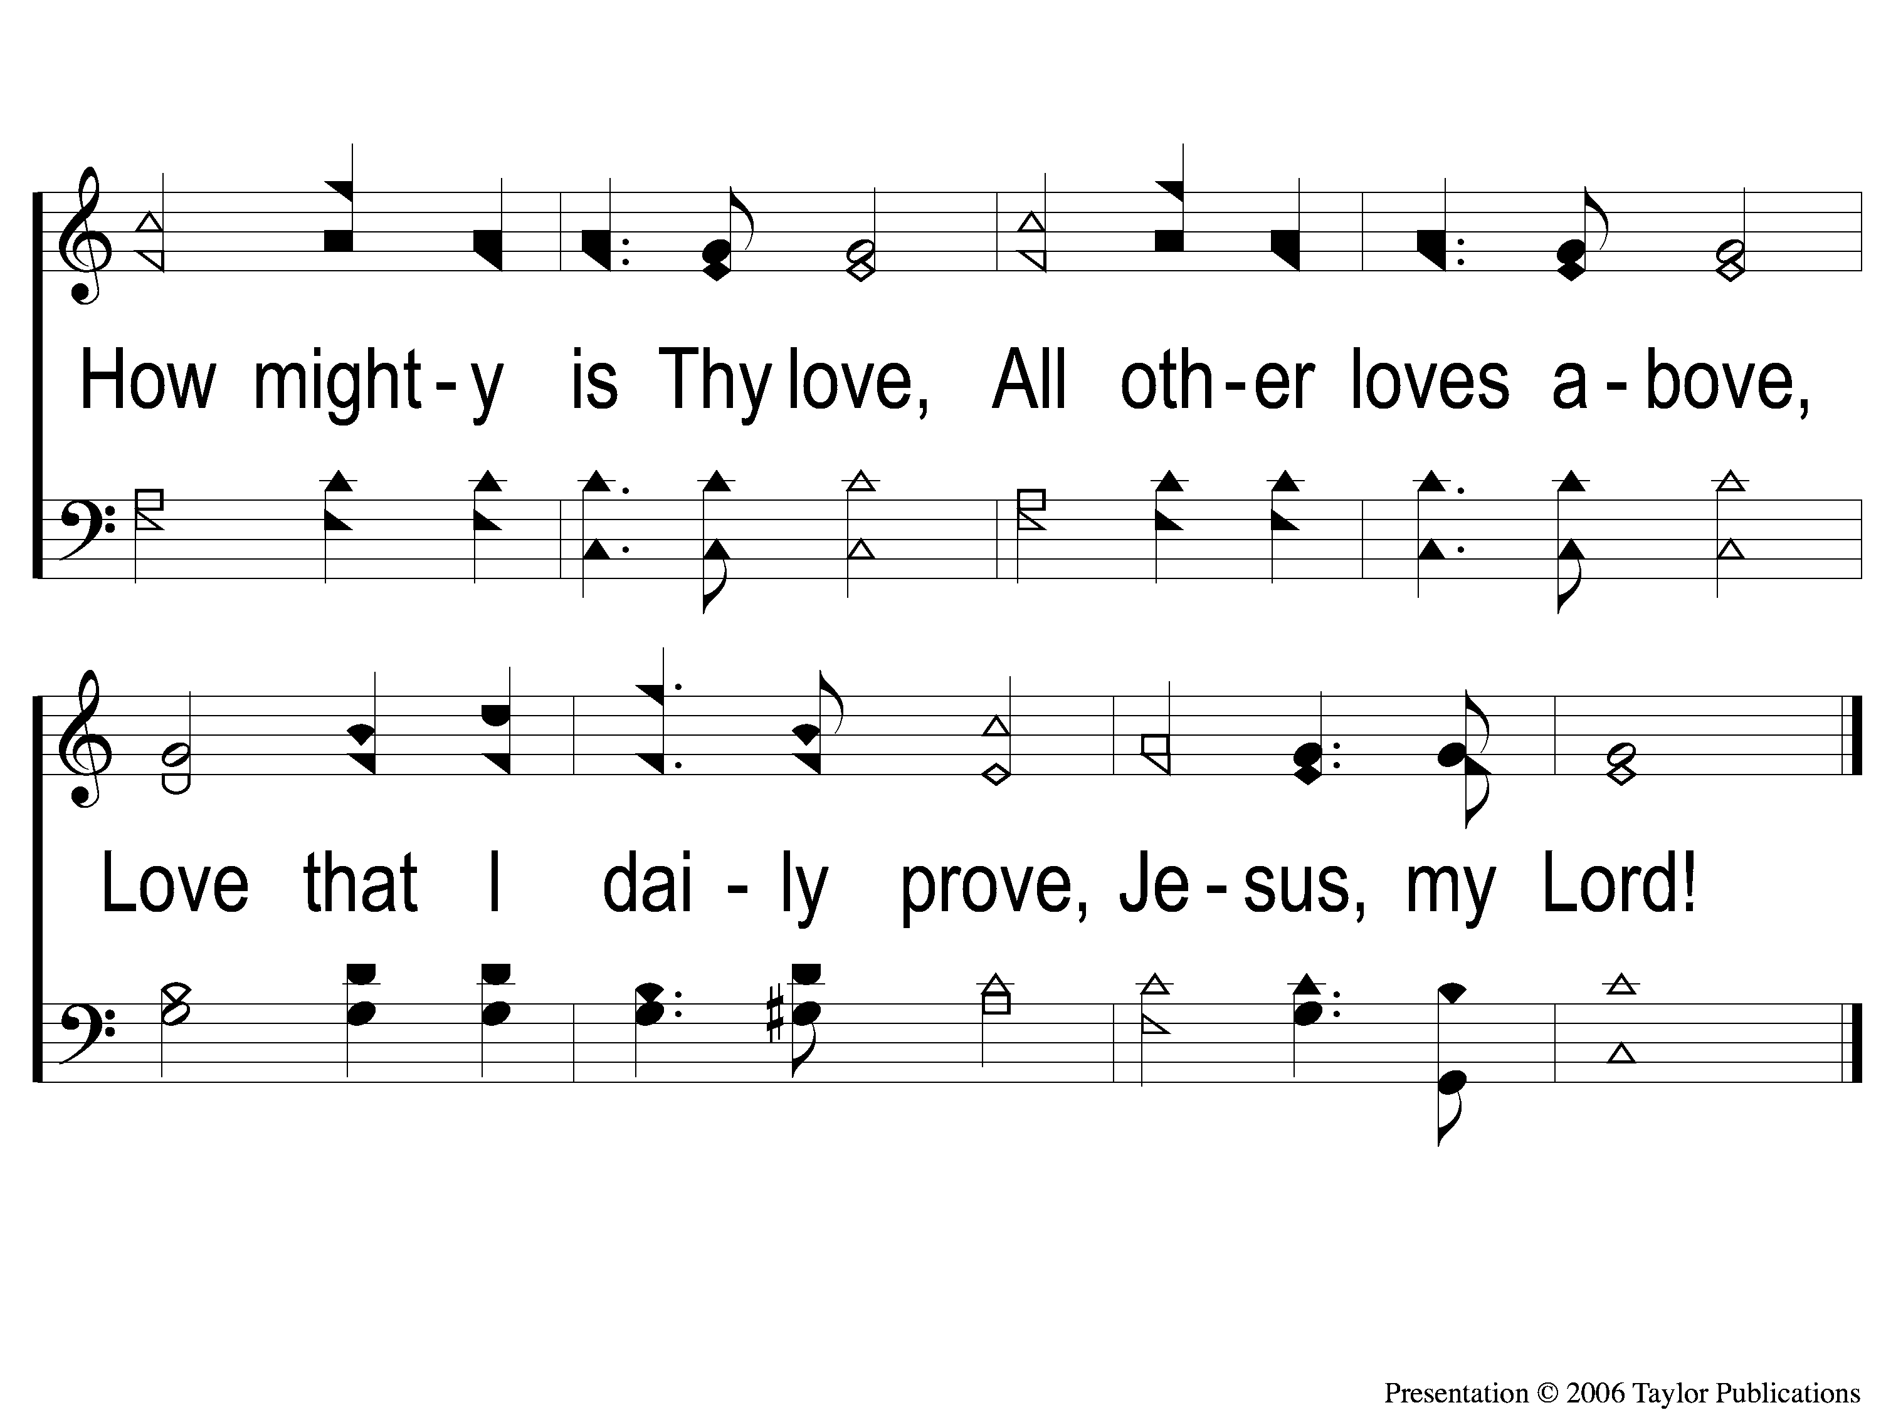
2-2 Jesus Thy Name I Love
Jesus, Thy Name I Love
151

Slide 5
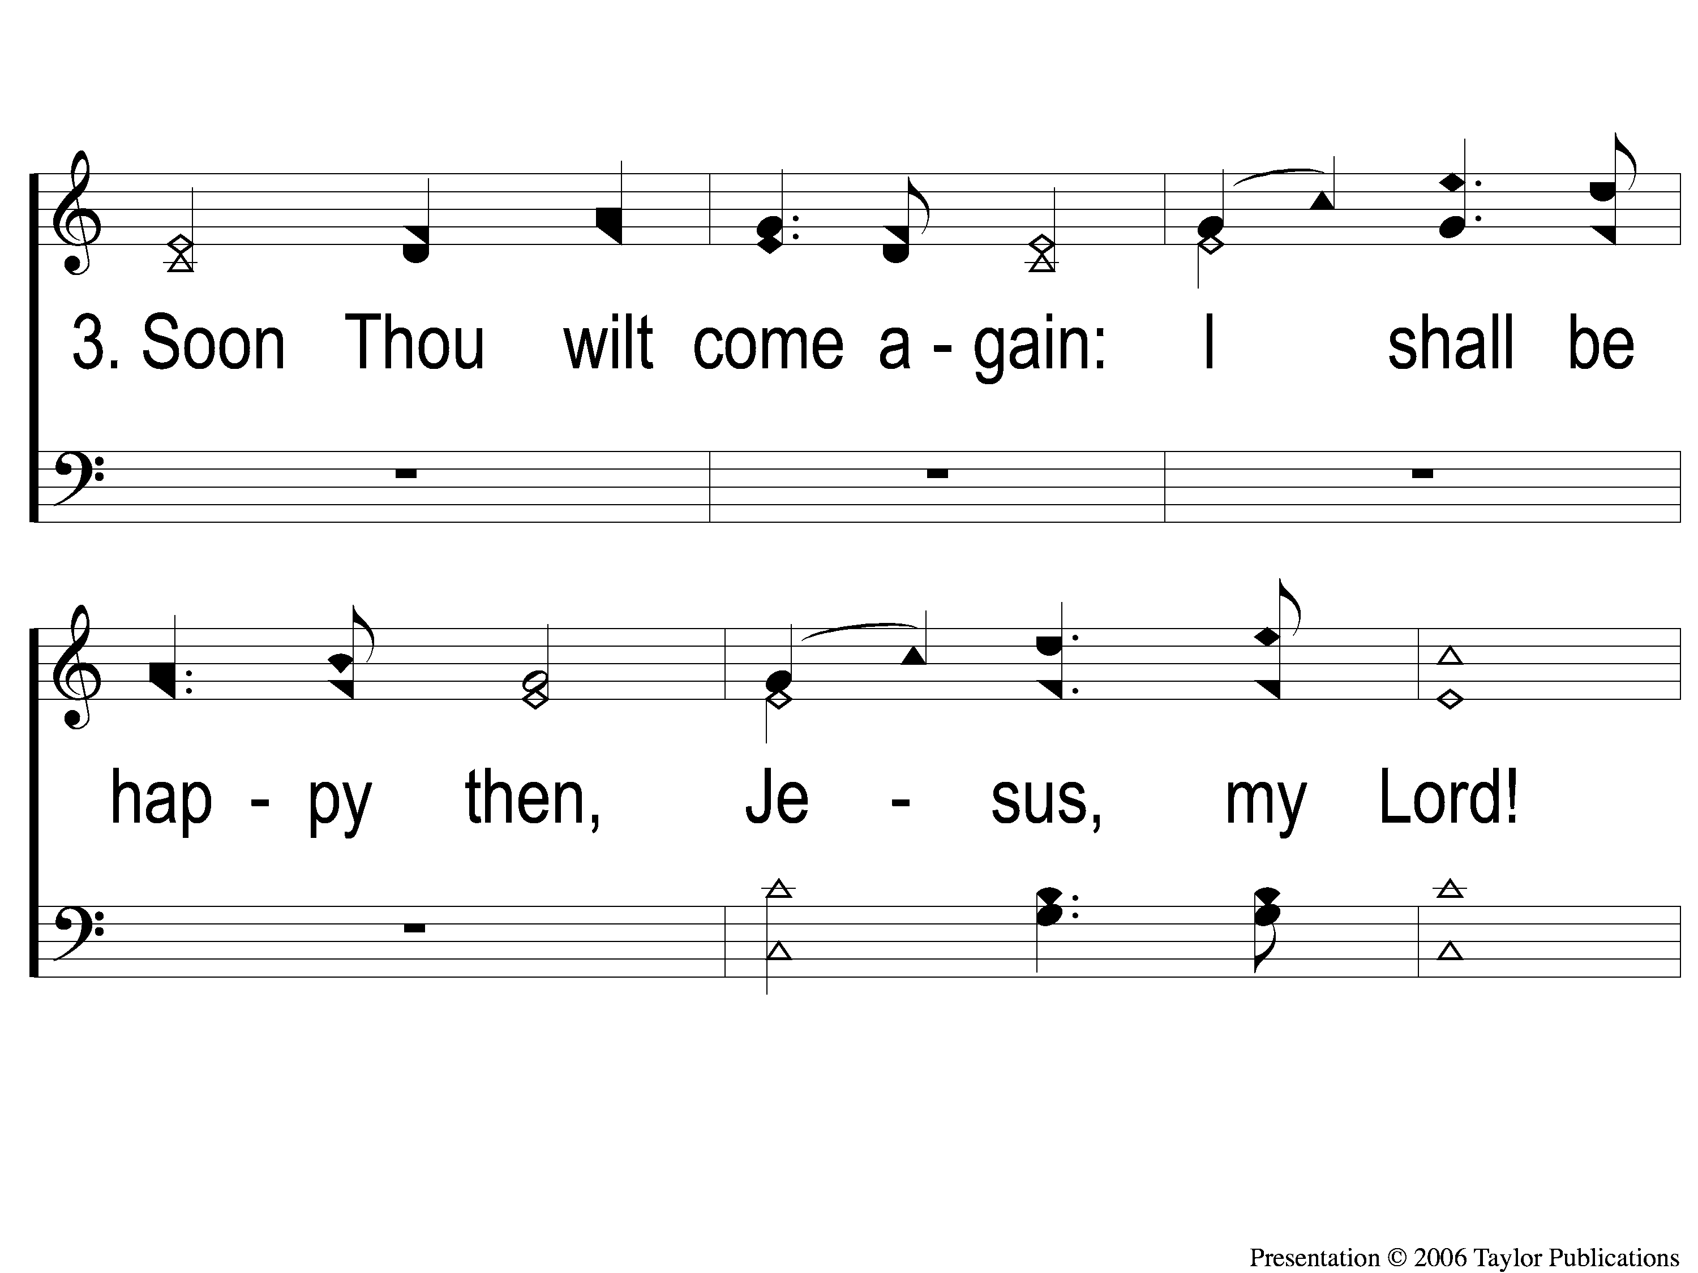
3-1 Jesus Thy Name I Love
Jesus, Thy Name I Love
151

Slide 6
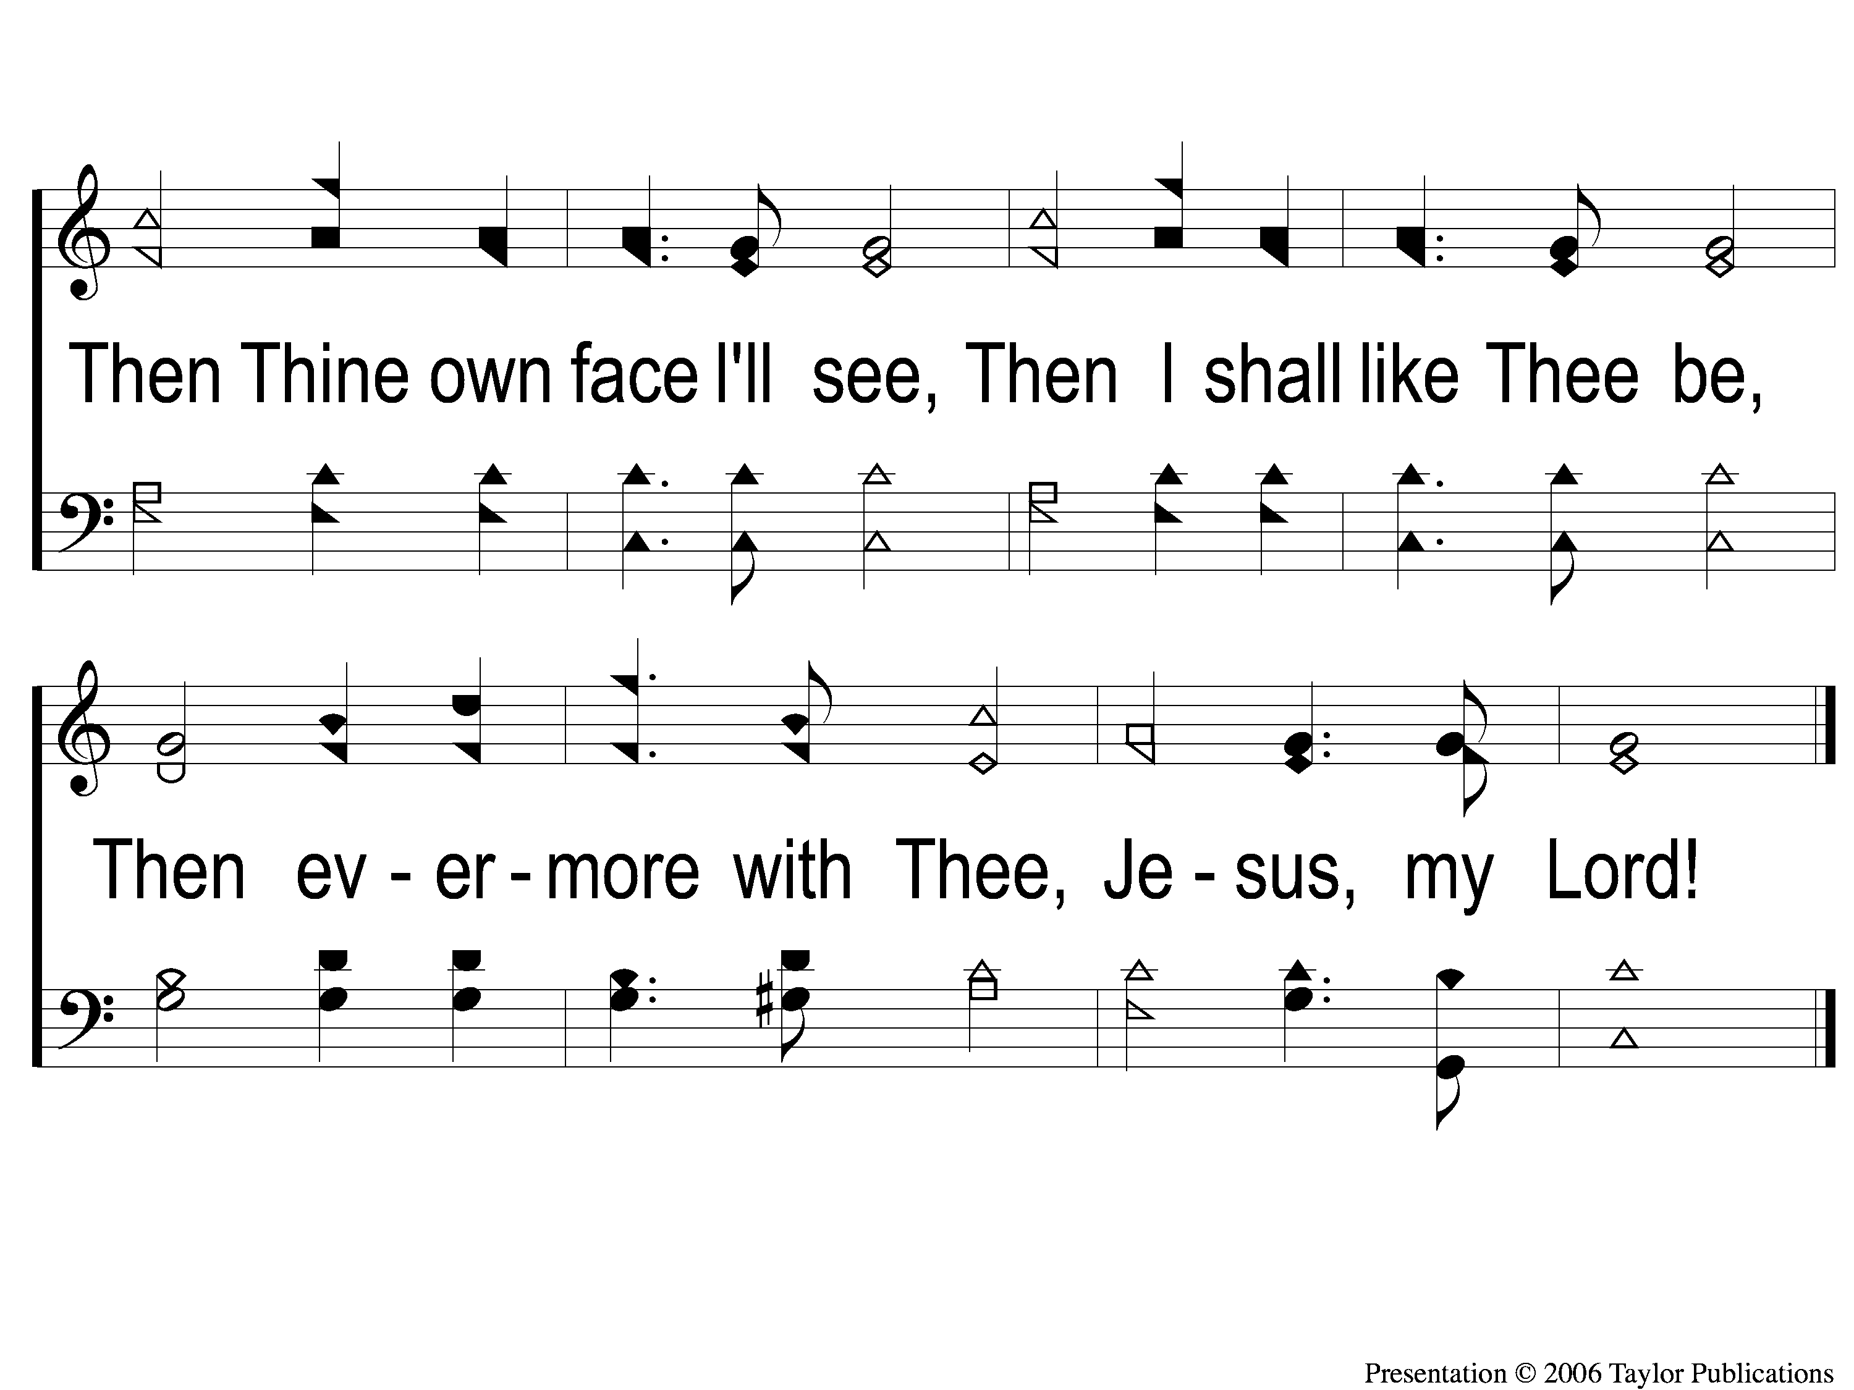
3-2 Jesus Thy Name I Love
Jesus, Thy Name I Love
151

